Slide 1

Examining the Performance of Satellite Propagators for Autonomous Space-Situational-Awareness Satellites
Capstone Project Phase B
24-2-R-13
Mahran Abed Ellatif
Shadi Abed Alkarem
Supervisor: Elad Denenberg

Slide 2
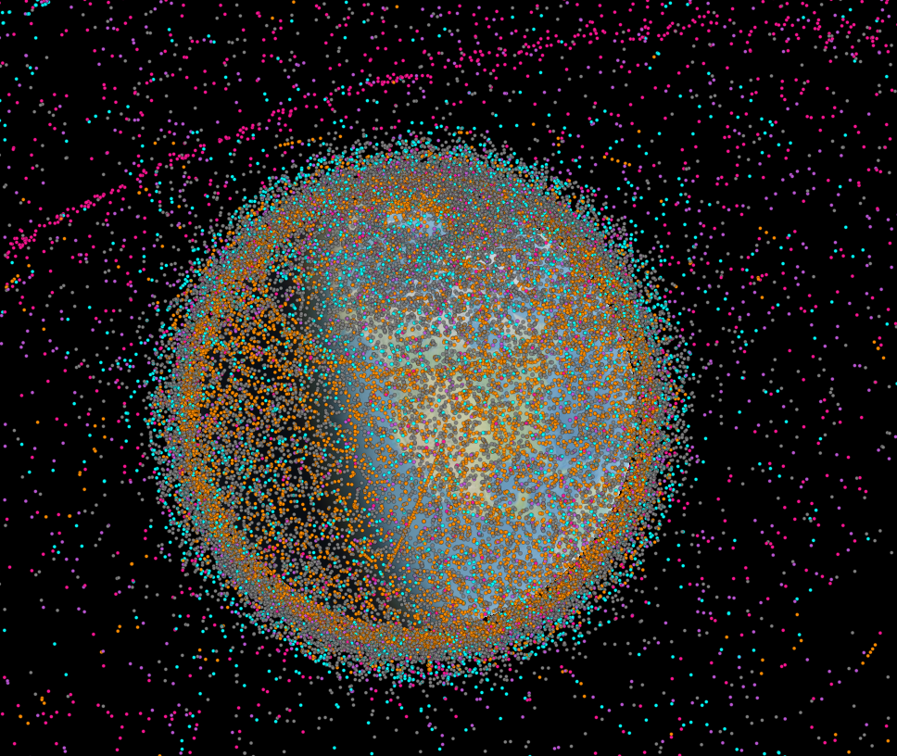
Introduction
Active\Old Satellites, Space debris
The growing space debris problem
Importance of autonomous navigation and collision avoidance
six state propagation algorithms
Active satellites[orange]
Inactive satellites[Blue]
Space debris[Grey]
Rocket bodies[purple]
Uncategorized[pink]
1
2
3
4
5
6
7
8
9
10
Introduction
Background
Objective
Algorithms
Analysis
Testing
Results
Conclusion
Future Work

Slide 3
Introduction
Brief overview of Phase One:
Phase one assessed six state propagation algorithms (RK4, RK8, ODE45, ODE78, ODE113, MPCI) with constant step size and the first equation of motion.
Focus of Phase Two:
Introduce dynamic step sizes to enhance computational accuracy and efficiency.
Iintegrate realistic forces (drag, perturbations).
Test in resource-constrained environments
1
2
3
4
5
6
7
8
9
10
Introduction
Background
Objective
Algorithms
Analysis
Testing
Results
Conclusion
Future Work

Slide 4
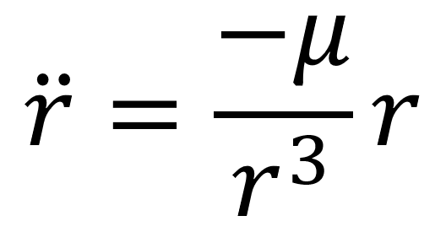
Background & Related Work
Phase One:
Fixed step size limited accuracy over long durations.
SGP4 as a baseline
Focused on the first equation of motion
1
2
3
4
5
6
7
8
9
10
Introduction
Background
Objective
Algorithms
Analysis
Testing
Results
Conclusion
Future Work
4

Slide 5
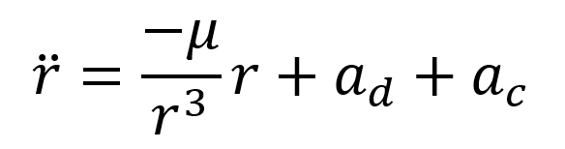
Phase Two:
Transition from constant to dynamic step sizes using Gauss-Lobatto quadrature.
Customized ODE78 serves as the baseline
Incorporates external forces: drag and perturbations (second equation of motion)
Introducing adaptive Picard Chebyshev Iteration (APCI)
VM Simulation
1
2
3
4
5
6
7
8
9
10
Introduction
Background
Objective
Algorithms
Analysis
Testing
Results
Conclusion
Future Work
5

Slide 6
Objectives
Achieve higher accuracy and computational efficiency by refining Phase One algorithms
Implement and analyse the Adaptive Picard-Chebyshev Iteration (APCI)
Test algorithms under realistic satellite constraints (virtual machine)
Generate visual comparisons of satellite trajectories and algorithm performance
1
2
3
4
5
6
7
8
9
10
Introduction
Background
Objective
Algorithms
Analysis
Testing
Results
Conclusion
Future Work
6

Slide 7
Algorithms in the study
Over view
4th Order Runge-Kutta method-RK4
8th Order Runge-Kutta method-RK8
Dormand-Prince Method-ODE45
Verner’s Method-ODE78
Adam-Bashforth-Moulton PECE Solver-ODE113
Adaptive Picard-Chebyshev Iteration -APCI
1
2
3
4
5
6
7
8
9
10
Introduction
Background
Objective
Algorithms
Analysis
Testing
Results
Conclusion
Future Work
7

Slide 8
Algorithms Analysis
4th Order Runge-Kutta method-RK4
Numerical solution for ODE’s
Balance between accuracy and computational efficiency
Key Points
Time Complexity O(N)
Space Complexity O(N) – ” Originally O(1)”
Suitable for-time Application with moderate accuracy requirements
1
2
3
4
5
6
7
8
9
10
Introduction
Background
Objective
Algorithms
Analysis
Testing
Results
Conclusion
Future Work
8

Slide 9
Algorithms Analysis
8th Order Runge-Kutta method-RK8
High-Order accuracy with higher computational cost
Key Points
Time Complexity O(N)
Space Complexity O(N) – ” Originally O(1)”
Suitable for precise but less time-constrained applications
1
2
3
4
5
6
7
8
9
10
Introduction
Background
Objective
Algorithms
Analysis
Testing
Results
Conclusion
Future Work
9

Slide 10
Algorithms Analysis
Dormand-Prince Method-ODE45
Adaptive step size method, Balances accuracy and efficiency
Key Points
Time Complexity O(N)
Space Complexity O(N) – ” Originally O(1)”
Useful for varied solution behavior
1
2
3
4
5
6
7
8
9
10
Introduction
Background
Objective
Algorithms
Analysis
Testing
Results
Conclusion
Future Work
10

Slide 11
Algorithms Analysis
Verner’s Method-ODE78
Provides high accuracy with variable step size for efficiency
Key Points
Time Complexity O(N)
Space Complexity O(N) – ” Originally O(1)”
Suitable for high-precision applications where stringent accuracy is required
1
2
3
4
5
6
7
8
9
10
Introduction
Background
Objective
Algorithms
Analysis
Testing
Results
Conclusion
Future Work
11

Slide 12
Algorithms Analysis
Adam-Bashforth-Moulton PECE Solver-ODE113
Predicts using explicit methods and corrects using implicit methods
Key Points
Time Complexity O(N)
Space Complexity O(N) – ” Originally O(1)”
Efficient for non-stiff problem over long time intervals
1
2
3
4
5
6
7
8
9
10
Introduction
Background
Objective
Algorithms
Analysis
Testing
Results
Conclusion
Future Work
12

Slide 13
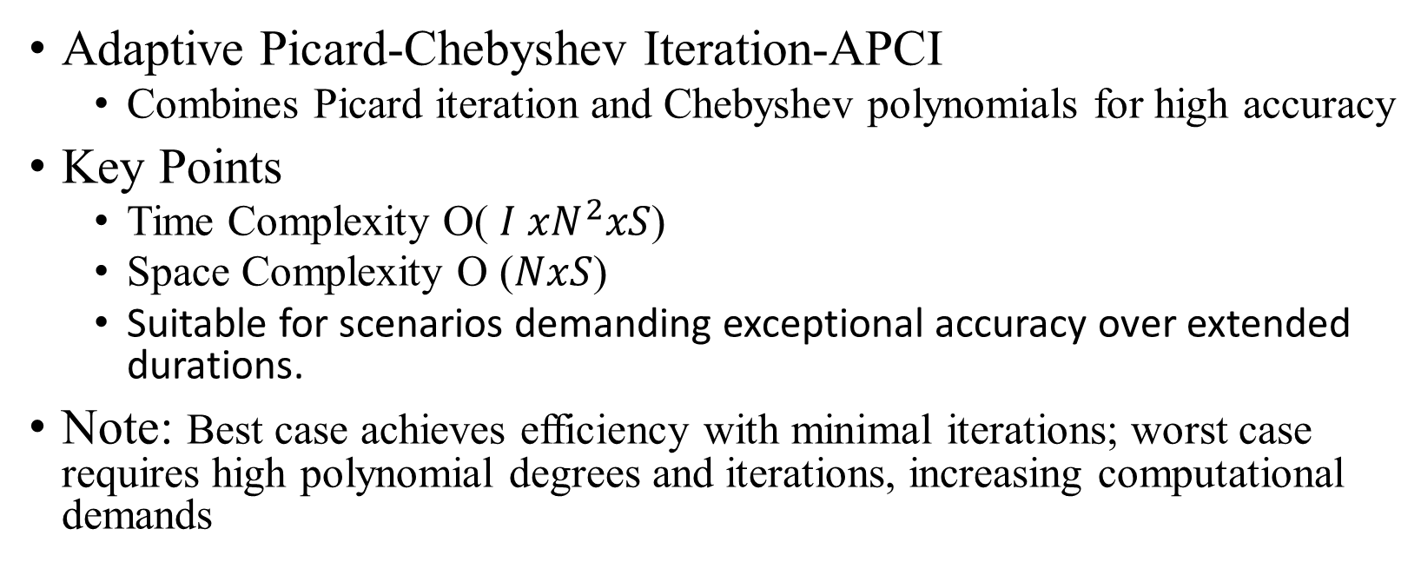
Algorithms Analysis
Adaptive Picard-Chebyshev Iteration-APCI
Combines Picard iteration and Chebyshev polynomials for high accuracy
Key Points
Time Complexity O( $I{ xN}^{2}xS$)
Space Complexity O ($NxS$)
Suitable for scenarios demanding exceptional accuracy over extended durations.
Note: Best case achieves efficiency with minimal iterations; worst case requires high polynomial degrees and iterations, increasing computational demands
1
2
3
4
5
6
7
8
9
10
Introduction
Background
Objective
Algorithms
Analysis
Testing
Results
Conclusion
Future Work
13

Slide 14
Testing Setup
Simulated 1 million seconds for five satellites:
LEO: STARLINK-1341, IRIDIUM 33 DEB, QIANFAN-4.
HEO: SKYNET 4C, ASBM-2.
Orbital periods segmented into:
8 and 16 segments.
Each segment divided into 16 Gauss-Lobatto points.
Virtual machine setup:
<64 MB memory, single-core CPU at 500 MHz.
Time constraints prevented testing the first equation of motion
1
2
3
4
5
6
7
8
9
10
Introduction
Background
Objective
Algorithms
Analysis
Testing
Results
Conclusion
Future Work
14

Slide 15
Results Overview
We evaluated the accuracy of each algorithm by comparing their results to Ode78 Baseline model.
Execution time was also a critical factor in assessing their practicality for real-time applications.
the results revealed trade-offs between computational efficiency and accuracy across different algorithms.
1
2
3
4
5
6
7
8
9
10
Introduction
Background
Objective
Algorithms
Analysis
Testing
Results
Conclusion
Future Work
15

Slide 16
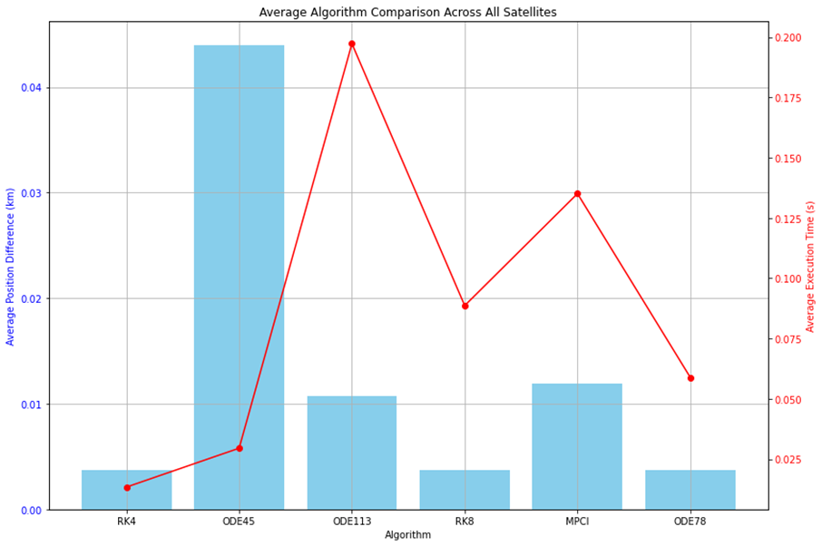
Phase 1 results over 30 seconds
1
2
3
4
5
6
7
8
9
10
Introduction
Background
Objective
Algorithms
Analysis
Testing
Results
Conclusion
Future Work
16

Slide 17
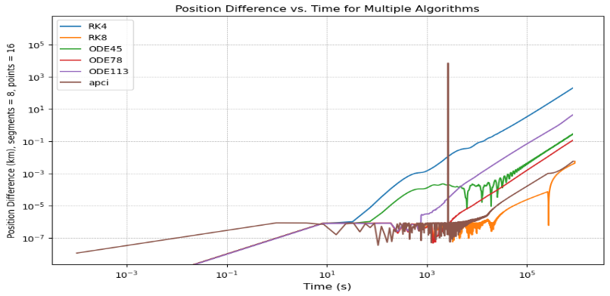
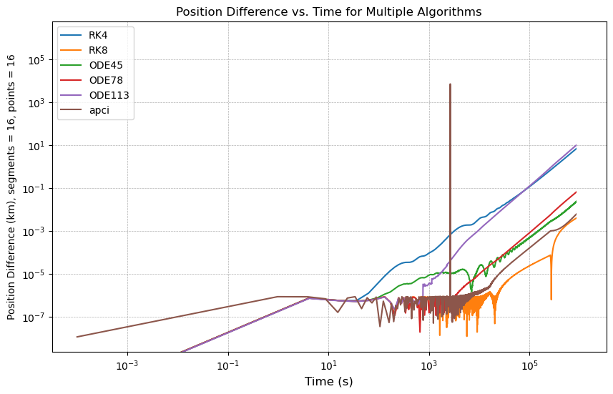
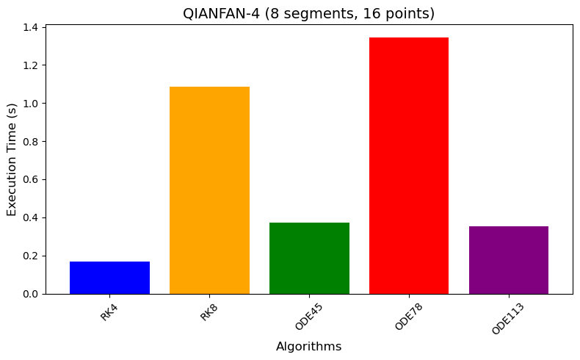
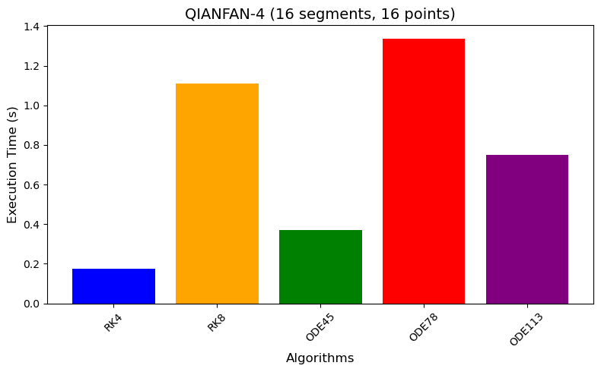
LEO – QIANFAN-4
1
2
3
4
5
6
7
8
9
10
Introduction
Background
Objective
Algorithms
Analysis
Testing
Results
Conclusion
Future Work
17

Slide 18
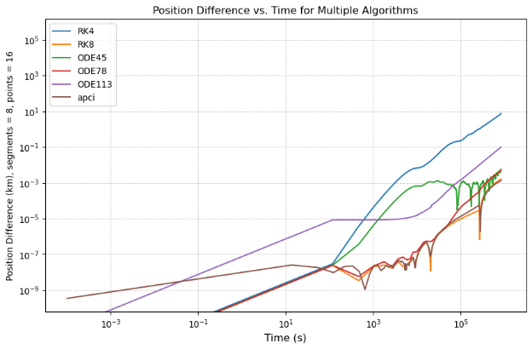
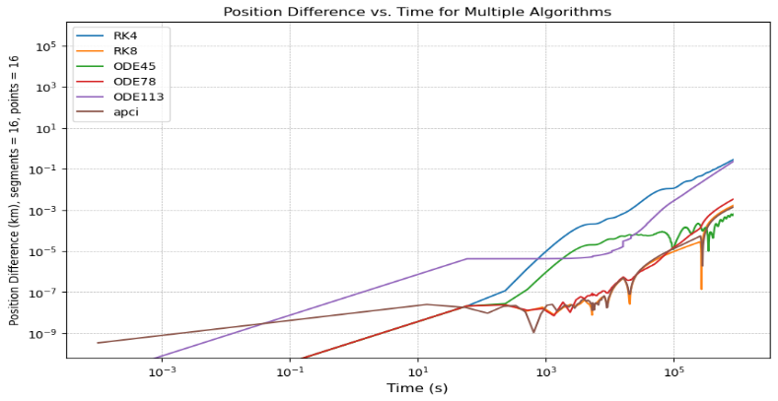
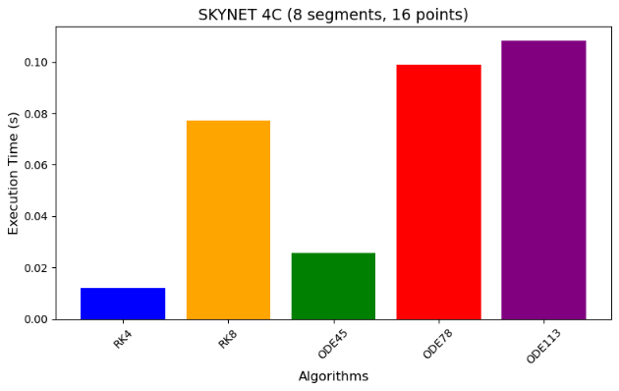
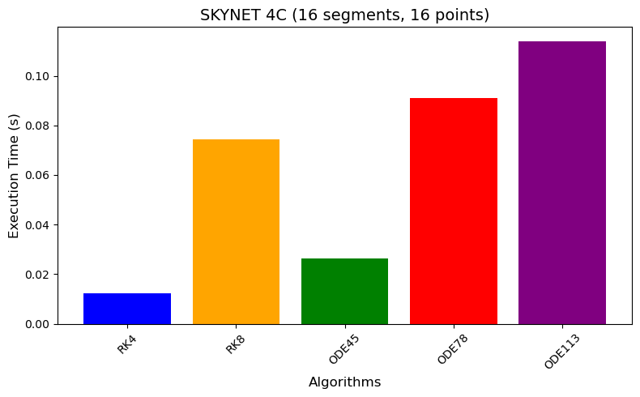
HEO – SKYNET-4C
1
2
3
4
5
6
7
8
9
10
Introduction
Background
Objective
Algorithms
Analysis
Testing
Results
Conclusion
Future Work
18

Slide 19
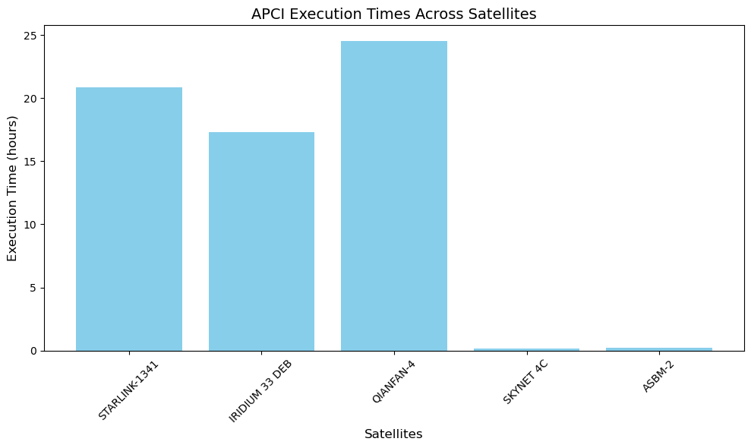
APCI – Execution Time
1
2
3
4
5
6
7
8
9
10
Introduction
Background
Objective
Algorithms
Analysis
Testing
Results
Conclusion
Future Work
19

Slide 20
Algorithms Results And Analysis
Accuracy:
RK8: Most accurate, especially for long durations.
ODE78: Close to RK8 but slower.
RK4: Significant position differences, suitable for less precision-critical tasks.
Execution Time:
Fastest to slowest: RK4, ODE45, RK8, ODE113, ODE78.
APCI: Exceptionally slow, taking up to one day for a single test
1
2
3
4
5
6
7
8
9
10
Introduction
Background
Objective
Algorithms
Analysis
Testing
Results
Conclusion
Future Work
20

Slide 21
Conclusion
RK8: Best balance of accuracy and efficiency.
RK4: Ideal for time-critical tasks where lower accuracy is acceptable.
APCI: Accurate but impractical for real-time applications.
Dynamic step sizes and Gauss-Lobatto quadrature improved accuracy and stability.
1
2
3
4
5
6
7
8
9
10
Introduction
Background
Objective
Algorithms
Analysis
Testing
Results
Conclusion
Future Work
21

Slide 22
Future Work
Reprepare and submit the findings for publication once more
Integration with time of closest approach computation software
Optimize APCI for practical use.
Extend testing to real CubeSat environments.
Refine algorithms for onboard satellite implementation.
1
2
3
4
5
6
7
8
9
10
Introduction
Background
Objective
Algorithms
Analysis
Testing
Results
Conclusion
Future Work
22

Slide 23
Thank you
References
Kessler, D. J., & Cour-Palais, B. G. (1978). Collision frequency of artificial satellites: The creation of a debris belt.
https://www.researchgate.net/publication/23888776_Collision_frequency_of_artificial_satellites_-_The_creation_of_a_debris_belt
Runge, C. (1895). Über die numerische Auflösung von Differentialgleichungen. Mathematische Annalen.
https://www.researchgate.net/publication/230873346_Uber_die_numerische_Auflosung_von_Differentialgleichungen
Kutta, W. (1901). Beitrag zur näherungsweisen Integration totaler Differentialgleichungen. Zeitschrift für Mathematik und Physik.
https://www.researchgate.net/publication/200175415_Beitrag_zur_Naherungsweisen_Integration_totaler_Differentialgleichungen
Dormand, J. R., & Prince, P. J. (1980). A family of embedded Runge-Kutta formulae. Journal of Computational and Applied Mathematics.
https://www.researchgate.net/publication/222465749_A_Family_of_Embedded_Runge-Kutta_Formulae
Verner, J. L. (1988). A family of explicit Runge-Kutta methods for the numerical solution of ordinary differential equations ACM Transactions on Mathematical Software
https://dl.acm.org/doi/10.1145/285861.285863
Linear multistep method (Adam-bushforth-multon Formulas)
https://en.wikipedia.org/wiki/Linear_multistep_method
Denenberg, Elad. "Satellite closest approach calculation through Chebyshev Proxy Polynomials.“
https://www.researchgate.net/publication/338609111_Satellite_Closest_Approach_Calculation_Through_Chebyshev_Proxy_Polynomials
Woodland, R. A., & Junkins, J. L. (2007). Modified Picard-Chebyshev Iteration Methods for Solving Differential Equations. Journal of Computational Physics.
https://www.researchgate.net/publication/330092401_Nonlinear_Differential_Equation_Solvers_via_Adaptive_Picard-Chebyshev_Iteration_Applications_in_Astrodynamics
1
2
3
4
5
6
7
8
9
10
Introduction
Background
Objective
Algorithms
Analysis
Testing
Results
Conclusion
Future Work
23

